Slide 1
W.A.D.E Widget Application Display Engine
An Advanced Programming Methods Project

Slide 2
Project Description
A widget viewer software.
Users configure multiple widgets for display on their window.
Initially developed for Raspberry Pi. Ultimately can be expanded and designed to run on any display.
Widgets are designed to provide and receive live data of different formats – provided via TCP/IP communication.
For every widget, the server enables data polling from any given source.

Slide 3
Architectural Pattern Used
Project’s Architecture: based on the Client-Server pattern.
Client side – operates widgets management and display.
Server side – provides data for client requests. Thus, alternating data polling implementations remains cleaner and is managed only via server side.

Slide 4
Design Patterns Used
Factory
Singleton
Command
Iterator
Strategy
Facade

Slide 5
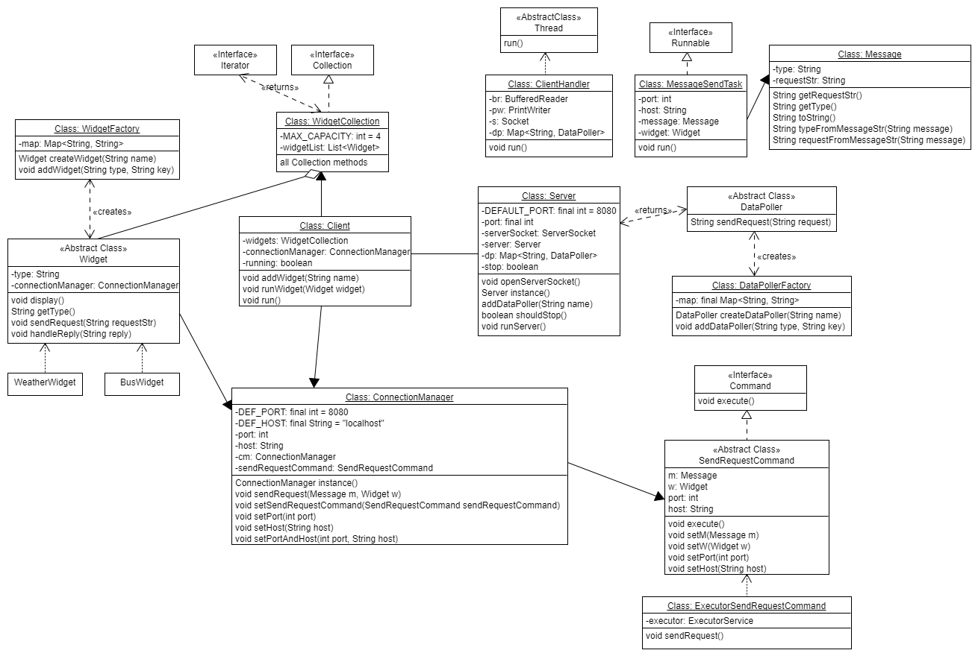

Slide 6
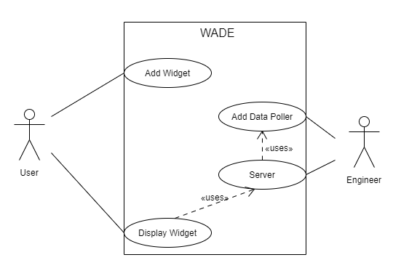

Slide 7
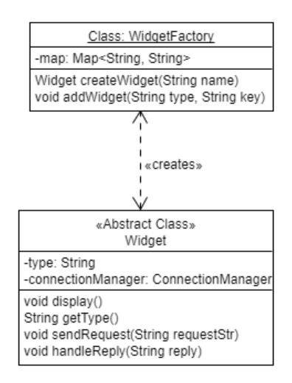
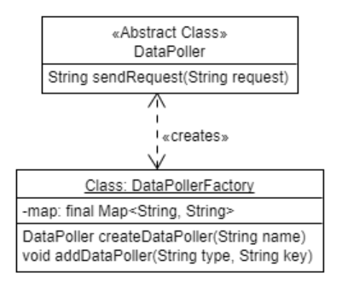
Factory Design Pattern
Implemented both for widgets and Data pollers creation.
Dynamic implementation with renaming option.

Slide 8
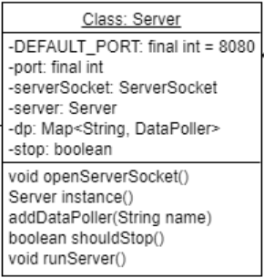
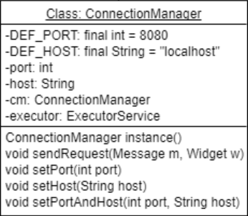
Singleton Design Pattern
Implemented by Server – for reasons such as port usage.

Slide 9
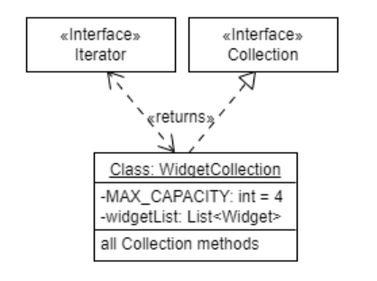
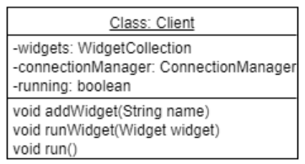
Iterator Design Pattern
WidgetCollection implements Collection interface
Client utilizes a widget iterator for iteration over the collection.

Slide 10
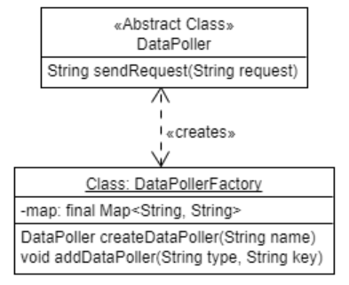
Strategy Design Pattern
The DataPoller determines polling methods, resources and strategies, e.g.: usage of databases, proxies, external services, etc.

Slide 11
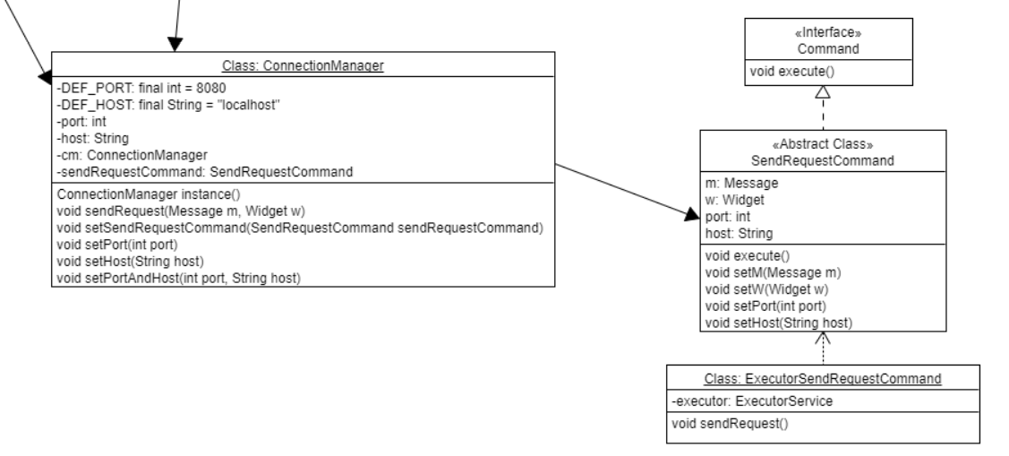
Command Design Pattern

Slide 12
Command Design Pattern
RequestSenderCommand – Defines action to be taken by the requests manager whenever a request is received.
MessageSendTask – Defines action to be taken when executed by the ExecutorService.

Slide 13
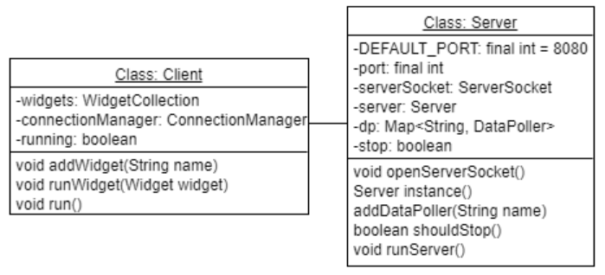
Client-Server Architectural Pattern
Server provides data for multiple clients – a single source.
A Client represents a Widget manager for display of received data.

Slide 14
Thank You!

